Slide 1
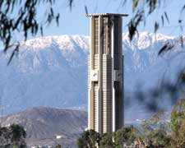
Learning Based Compact Thermal Modeling for Energy-Efficient Smart Building Management
Hengyang Zhao, Daniel Quach,
Shujuan Wang, Hai Wang,
Hai-Bao Chen, Xin Li,
Sheldon, X.-D. Tan
Department of Electrical Engineering
University of California, Riverside, CA

Slide 2
Outline
Motivation
Review of EnergyPlus program
Review of RNN architectures
RNN-based thermal modeling methods
Two RNN implementations
Cross validation for accuracy improvement
Experimental results
Summary

Slide 3
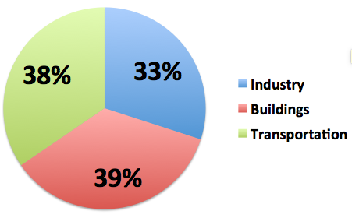
Motivation
Building section accounts for about 40% energy consumption in United States
Building section is also responsible for 70% of electricity use
About 50% of the energy consumed in buildings are directly related to space heating, cooling and ventilation (HVAC) [1]
For energy-efficient smart building, efficient HVAC control is required. Hence, compact yet accurate building thermal modeling is required

Slide 4

EnergyPlus Software
A fully integrated building, envelope, HVAC, water, and renewables simulation program
Originally based on BLAST and DOE-2.1E
Has rich GUI-based tools/plugins as front-end such as Google SketchUp.
Calculations are based on first-principle based numerical methods
High computational costs
Not suitable for control-based analysys
Needs detailed structures or equations of the thermal systems

Slide 5
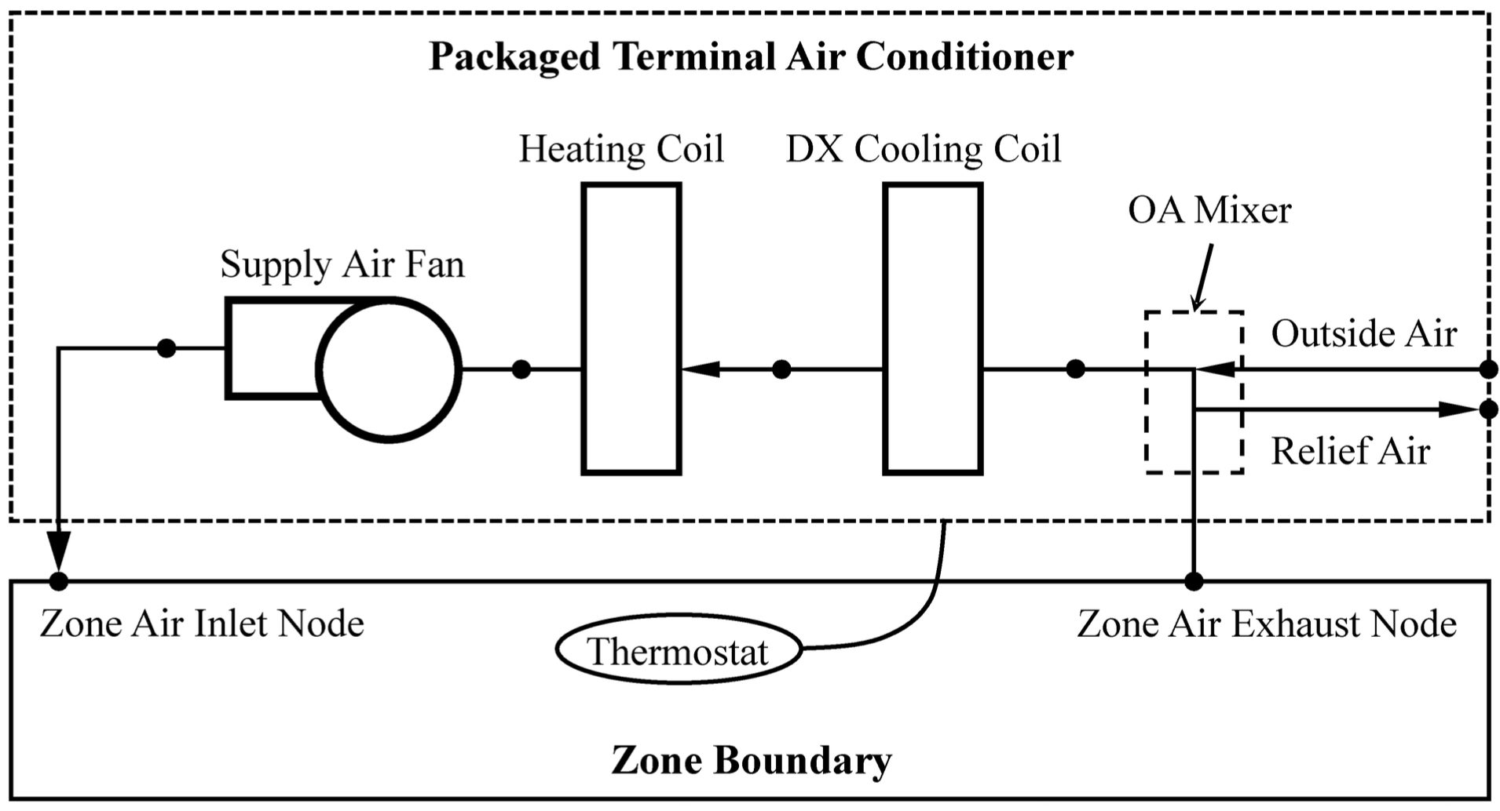
HVAC System

Slide 6
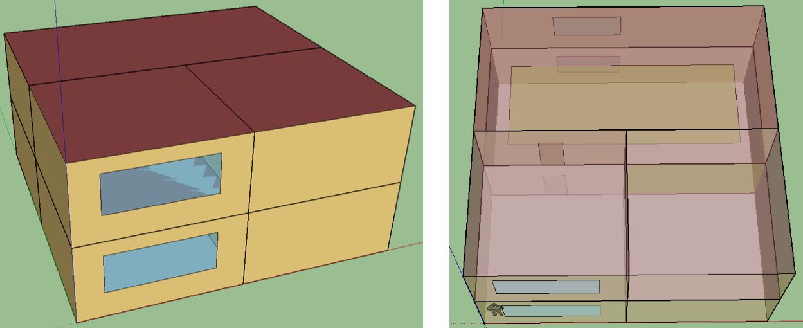
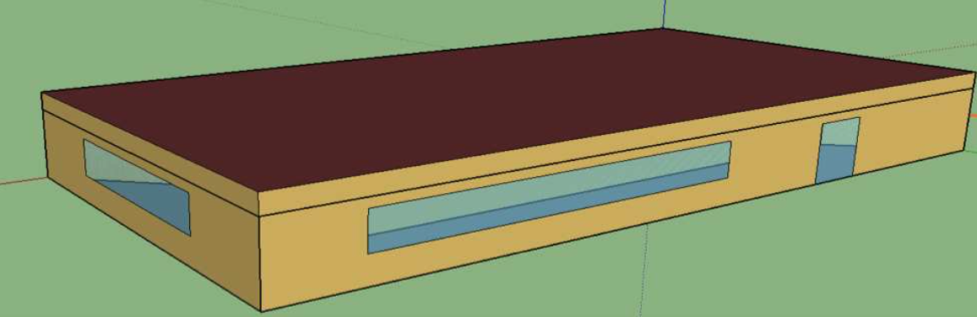
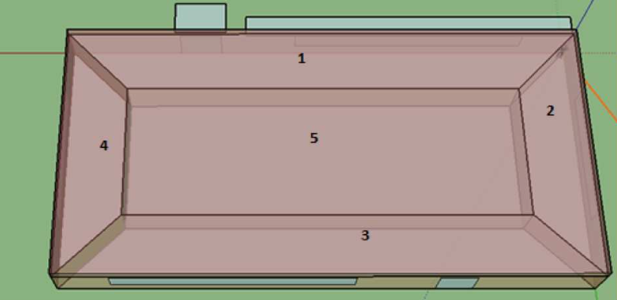
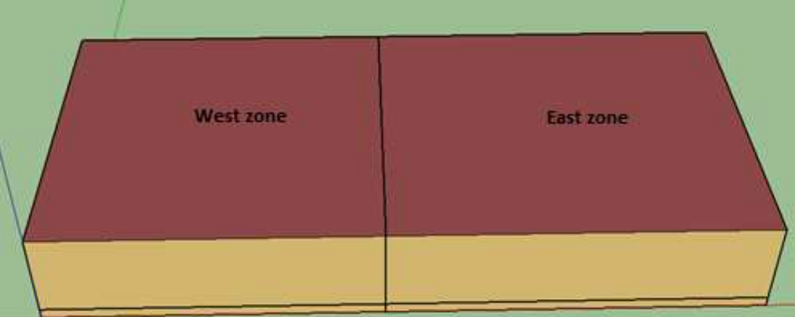
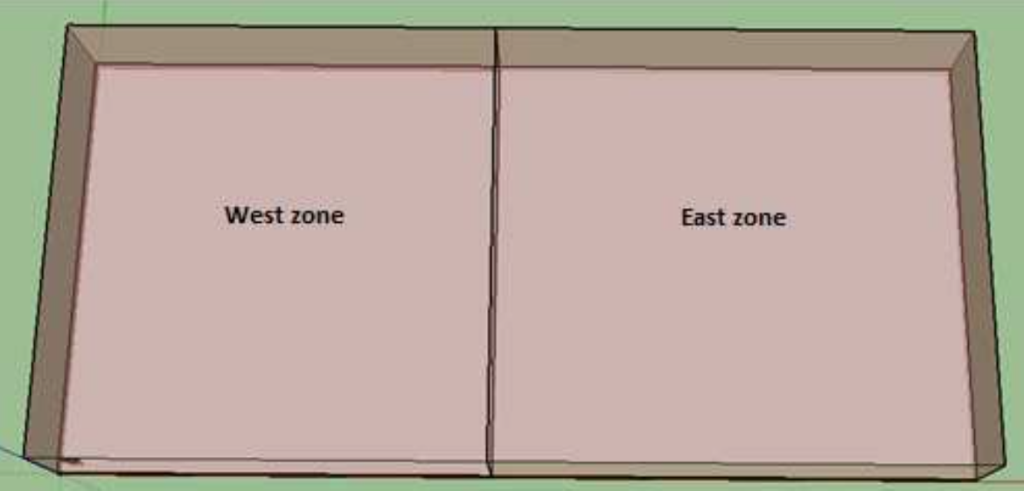
Some building cases from EnergyPlus
2-zone data center
5-zone office building
6-zone office building

Slide 7
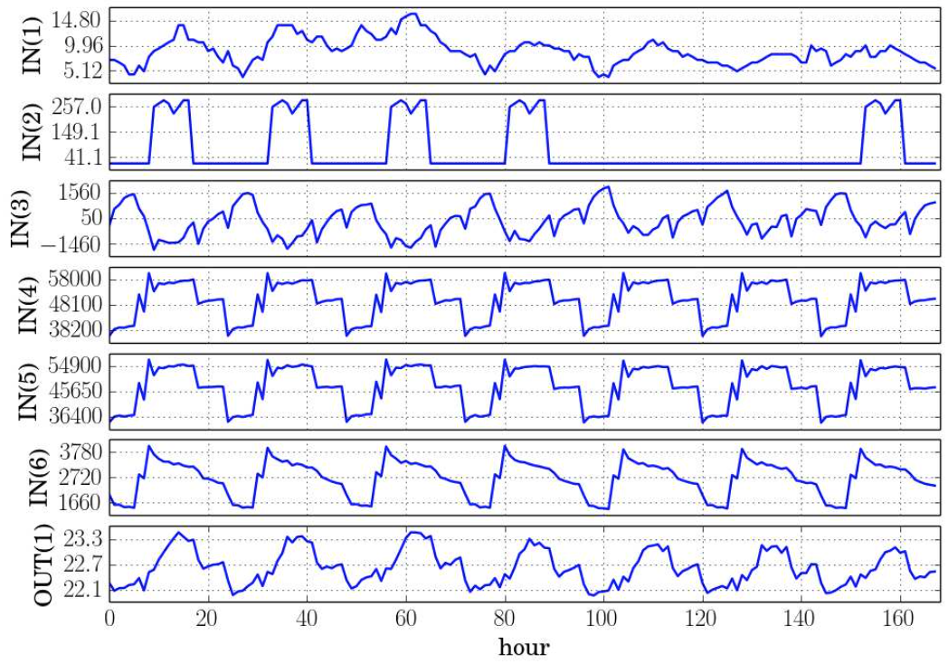
EnergyPlus Simulation
INPUTS: Ambient temperature, people factors, equipment factors, HVAC inputs, etc.
OUTPUTS: Temperatures of the interested spaces/rooms
Ambient Temperature
Light Heating Rate
Electrical Equipment Heating Rate
Ambient Temperature
Air System Cooling Rate (Zones)
Air System Cooling Rate (Plenum)

Slide 8
Non-linear control
Advanced control method is needed in order to minimize HVAC energy cost and meet the temperature goal
EKF: Extended Kalman Filter [2]
Computational cost is sensitive to number of state variables
We need a compact thermal model to describe the smart building system, with acceptable modeling error

Slide 9
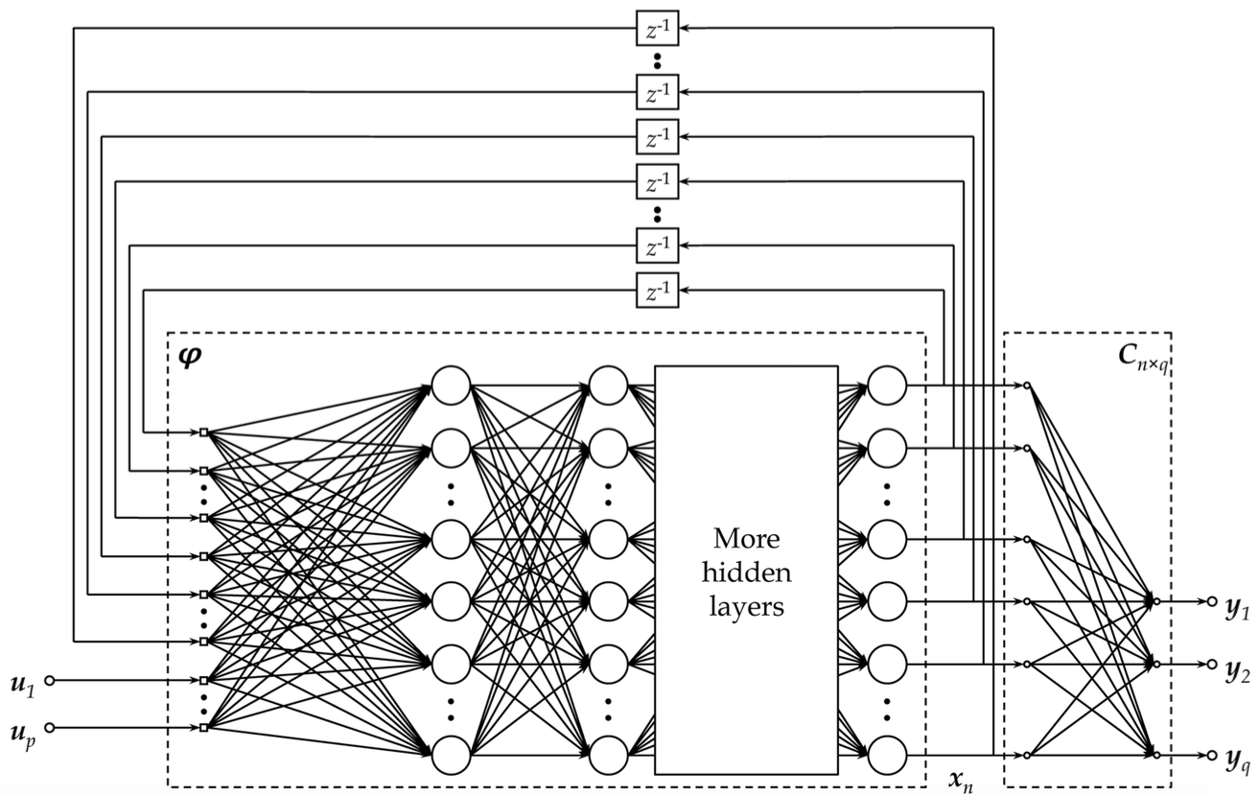
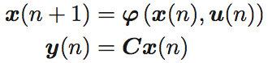
NLSS architecture
NLSS: Non-linear State Space neural network [3]
Closer to non-linear state space representation
Slightly higher variance in experiment

Slide 10
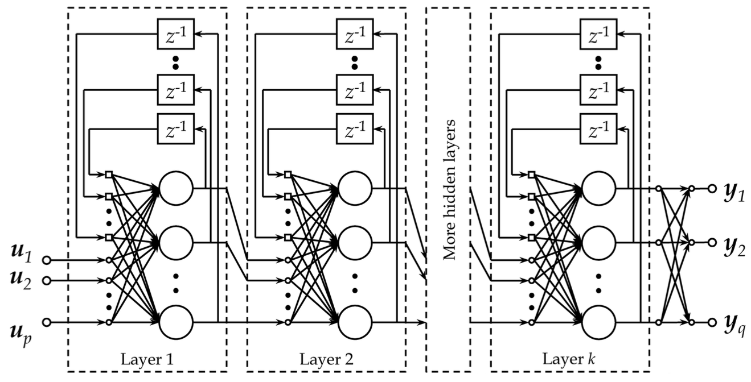
ELNN architecture
ELNN: Elman’s Neural Network [4] with local feedbacks
More works to extract the state variables (since they are everywhere with each layer)
Slightly lower variance in experiment

Slide 11
RNN for thermal model of building
Programmed in Python, with libraries PyBrain [5], NumPy [6], SciPy [7], Matplotlib [8]
2-norm regularization enabled in training to mitigate the over-fitting problem
We use RPropMinus [9], an adaptive back-propagation algorithm to train the RNNs
Input data is normalized before fed into the trainer to speed up training
Baseline data configuration:
Months 1-3, 5-7, 9-11 for training, 4, 8, 12 for validation

Slide 12
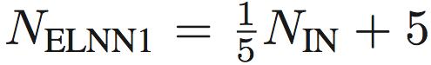



Network configurations
Empirical number of layers:
2 hidden layers for ELNN, 4 hidden layers for NLSS
Empirical size of layers:
ELNN
Hidden layer #1:
Hidden layer #2:
NLSS
Hidden layer #1-3:
Hidden layer #4:
Example: NLSS in 2-zone (all factors, #IN=11, #OUT=2): Uses layers with size (20, 20, 20, 2)

Slide 13
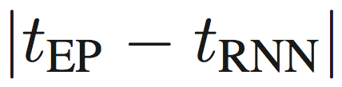
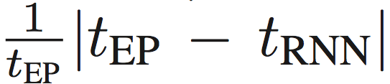
Error calculation
On each sampled output, we use two methods to calculate the modeling error
Absolute error: the actual difference between RNN output and EnergyPlus output:
Relative error: Absolute error divided by EnergyPlus output:
Average and maximum statistics are also calculated over the whole training data and validation data respectively

Slide 14
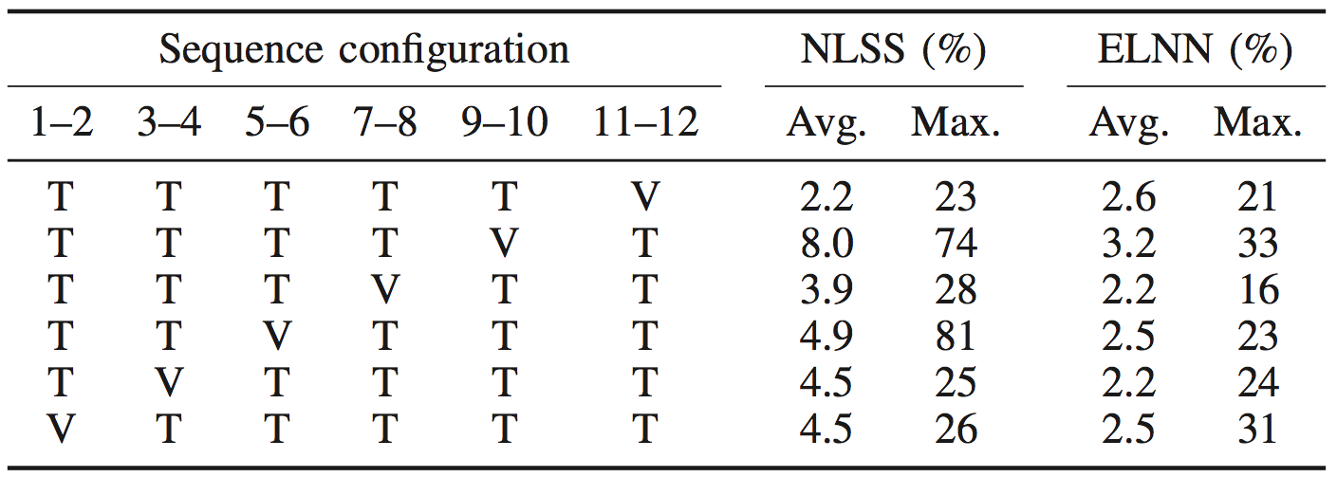
6-fold cross validation
We use every adjacent 2 months as a group
In each run of cross validation, we use one group to validate the model trained by the rest 5 groups
In 6-zone building RNNs
Validation error reduced from 34% to 23% in NLSS; from 23% to 16% in ELNN

Slide 15
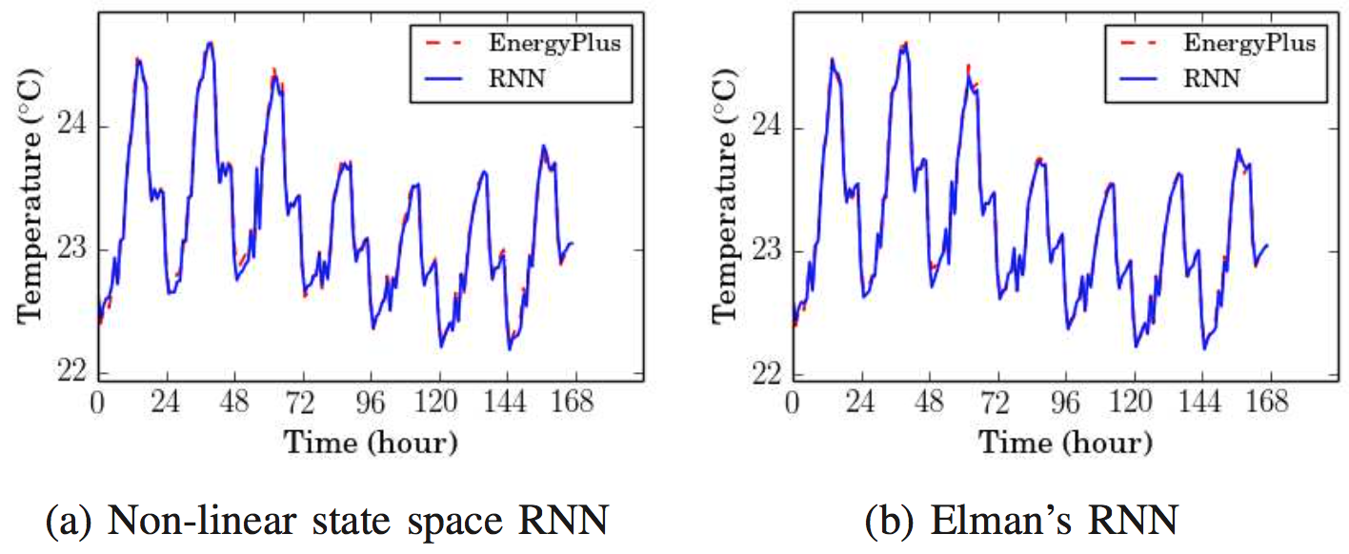
2-zone (all factors) modeling result
#IN=11, #OUT=2
Average error
ELNN 0.022°C/0.10%; NLSS 0.026°C/0.11%
Maximum error
ELNN 0.24°C/1.1%; NLSS 0.21°C/0.94%

Slide 16
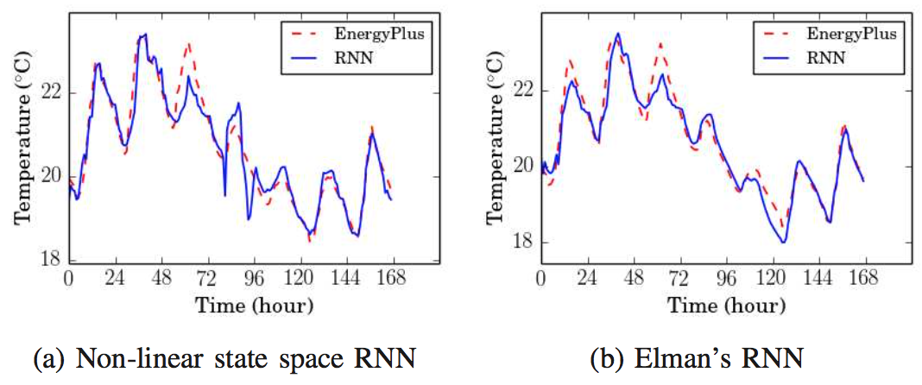
2-zone (HVAC) modeling result
#IN=3, #OUT=2
Average error
ELNN 0.20°C/0.98%; NLSS 0.23°C/1.2%
Maximum error
ELNN 1.34°C/6.5%; NLSS 1.4°C/7.0%

Slide 17
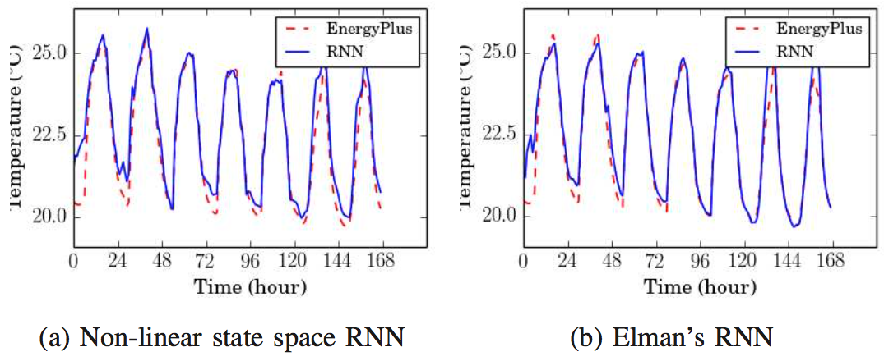
5-zone (all factors) modeling result
#IN=26, #OUT=5
Average error
ELNN 0.23°C/1.0%; NLSS 0.31°C/1.4%
Maximum error
ELNN 4.4°C/16%; NLSS 4.6°C/20%

Slide 18
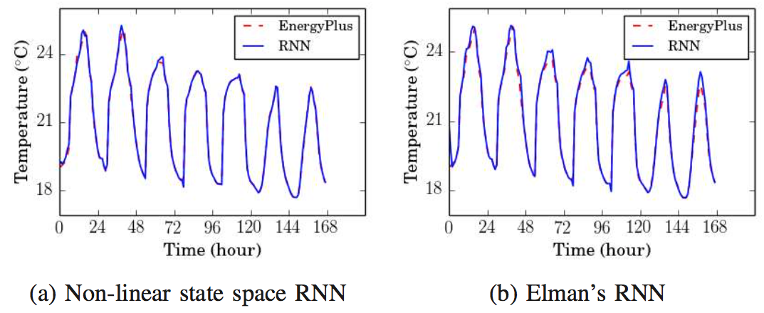
5-zone (HVAC) modeling result
#IN=6, #OUT=5
Average error
ELNN 0.16°C/0.71%; NLSS 0.057°C/0.26%
Maximum error
ELNN 2.2°C/12%; NLSS 2.2°C/9.6%

Slide 19
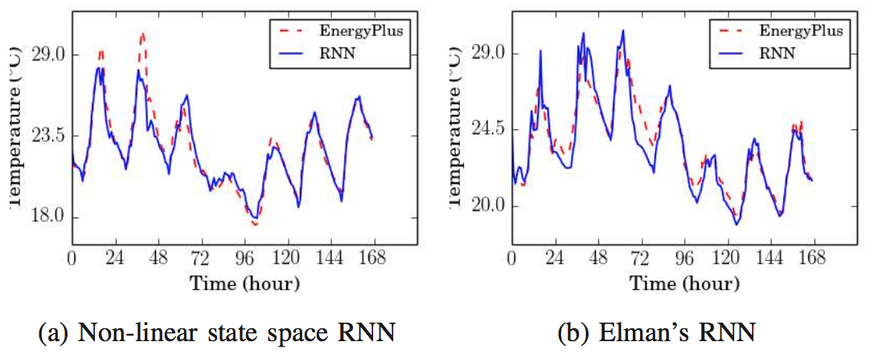
6-zone modeling result
#IN=55, #OUT=6
Average error
ELNN 0.53°C/2.2%; NLSS 0.48°C/2.2%
Maximum error
ELNN 4.1°C/16%; NLSS 4.8°C/23%

Slide 20
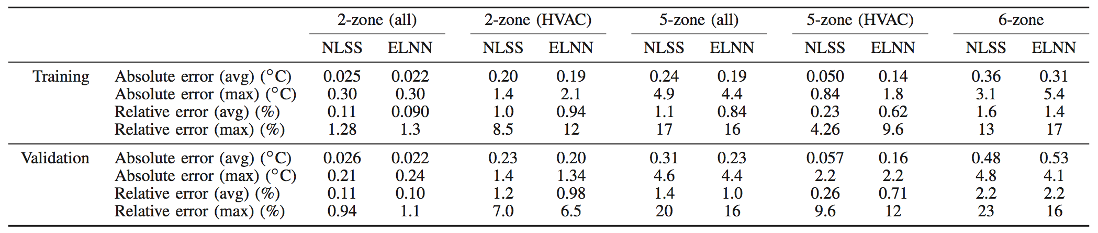
Summary
We did experiments on two RNN architectures on building thermal models
ELNN: Elman’s Neural Network with local feedbacks
NLSS: Non-Linear State Space Neural Network
We used cross-validation to reduce the modeling error on the 6-zone building case
Modeling errors
Simple 2-zone model: 1% ~ 1.5% relative error
Bigger 6-zone model: ELNN 16% and Elman 23%

Slide 21
Thank you!
Reference
[1] Building Energy Data Book of DOE. [Online]. http: //buildingsdatabook.eren.doe.gov
[2] M. Massoumy, Q. Zhu, C. Li, F. Meggers, and A. Sangiovanni-Vincentelli, “Co-design of Control Algorithm and Embedded Platform for Building HVAC Systems,” in International Conference on Cyber Physical Systems (ICCPS), Philadephia, PA, Apr. 2013, pp. 61–70.
[3] S. Haykin and N. Network, “A comprehensive fundation,” Neural Networks, vol. 2, no. 2004, 2004.
[4] J. L. Elman, “Finding structure in time,” Cognitive science, vol. 14, no. 2, pp. 179–211, 1990.
[5] T. Schaul, J. Bayer, D. Wierstra, Y. Sun, M. Felder, F. Sehnke, T. Ru ̈ckstieß, and J. Schmidhuber, “PyBrain,” Journal of Machine Learning Research, vol. 11, pp. 743–746, 2010.
[6] S. Van Der Walt, S. C. Colbert, and G. Varoquaux, “The numpy array: a structure for efficient numerical computation,” Computing in Science & Engineering, vol. 13, no. 2, pp. 22–30, 2011.
[7] E. Jones, T. Oliphant, P. Peterson et al., “SciPy: Open source scientific tools for Python,” 2001–, [Online; accessed 2015-07-23]. [Online]. Available: http://www.scipy.org/
[8] J. D. Hunter, “Matplotlib: A 2d graphics environment,” Computing in science and engineering, vol. 9, no. 3, pp. 90–95, 2007.
[9] C. Igel and M. Hu ̈sken, “Empirical evaluation of the improved rprop learning algorithms,” Neurocomputing, vol. 50, pp. 105–123, 2003.

